Slide 1
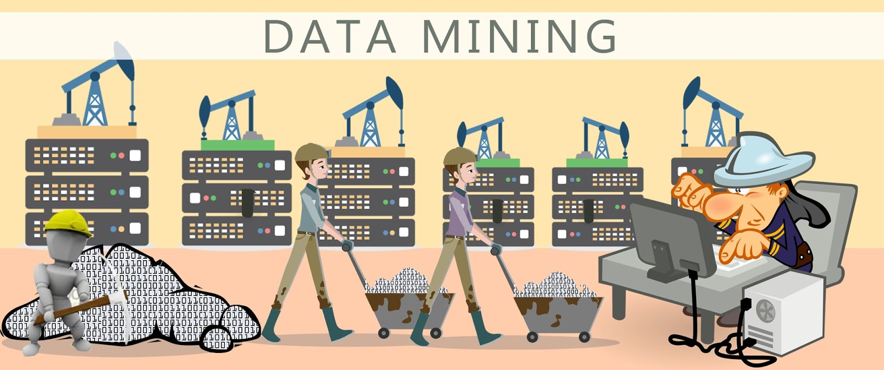

Slide 2
What is data mining?
As seen in the previous slide, what comes to mind when hearing about data mining is a miner with a pickaxe and some form of data. As crazy as it may sound that is data mining, in a way at least. You see we live in an era of information, and the amount of the information we daily get is huge, like a mountain where a mine would be located. To process all this information what we have to do is literally dig through it and find what we came for. What I mean by that, is that like a miner digs through dirt and rocks to fine gold or some valuable ore, we dig through the data, get rid of any useless to us, and find the information we want.

Slide 3
But what is considered useful?
Like a mine, data can provide a lot of valuable ores (information), what is valuable and what is not is up to the miner. For instance lets say you browse one day about mobile phones, and you notice that in certain sites there are ads about mobile phones because these sites use data mining to figure out what you want or looking for and try to provide it to you. Data mining could also be used in a maze lets say, where a computer could visualize different paths to the exit and give you the best way of getting out. In the end the goal is the extraction of patterns and knowledge from large amounts of data, not the extraction of data itself.

Slide 4
Mining methods
Neural networks, cluster analysis, genetic algorithms, decision trees and decision rules, and support vector machines. Data mining is the process of applying these methods with the intention of uncovering hidden patterns in large data sets. It bridges the gap from applied statistics and artificial intelligence to database management by exploiting the way data is stored and indexed in databases to execute the actual learning and discovery algorithms more efficiently, allowing such methods to be applied to ever larger data sets.

Slide 5
Process
Knowledge discovery in databases is usually defined with the stages:
Selection
Pre-processing
Transformation
Data mining
Interpretation/evaluation.
or a simplified process such as (1) Pre-processing, (2) Data Mining, and (3) Results Validation.

Slide 6
Pre-processing
Before data mining algorithms can be used, a target data set must be assembled. As data mining can only uncover patterns actually present in the data, the target data set must be large enough to contain these patterns while remaining concise enough to be mined within an acceptable time limit. A common source for data is a data mart or data warehouse. Pre-processing is essential to analyze the multivariate data sets before data mining. The target set is then cleaned. Data cleaning removes the observations containing noise and those with missing data.

Slide 7
Data Mining
Data mining involves six common classes of tasks:
Anomaly detection – The identification of unusual data records, that might be interesting or data errors that require further investigation.
Association rule learning – Searches for relationships between variables. For example, a supermarket might gather data on customer purchasing habits. Using association rule learning, the supermarket can determine which products are frequently bought together and use this information for marketing purposes.
Clustering – is the task of discovering groups and structures in the data that are in some way or another "similar", without using known structures in the data.
Classification – is the task of generalizing a known structure to apply to new data. For example, an e-mail program might attempt to classify an e-mail as "legitimate" or as "spam".
Regression – attempts to find a function which models the data with the least error that is, for estimating the relationships among data or datasets.
Summarization – providing a more compact representation of the data set, including visualization and report generation.

Slide 8
Results validation
Data mining can unintentionally be misused, and can then produce results which appear to be significant; but which do not actually predict future behaviour and cannot be reproduced on a new sample of data and bear little use. Often this results from investigating too many hypotheses and not performing proper statistical hypothesis testing. A simple version of this problem in machine learning is known as overfitting, but the same problem can arise at different phases of the process and thus a train/test split - when applicable at all - may not be sufficient to prevent this from happening.

Slide 9
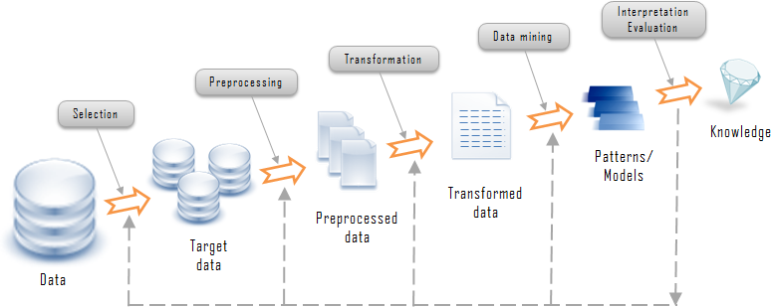
From dirt to diamond

Slide 10
Example Applications
Automatic number plate recognition
Customer analytics
Educational data mining
National Security Agency
Quantitative structure-activity relationship
Surveillance / Mass surveillance
Web mining
Drug discovery
Behavior information
Decision support system
Data analysis
Business Inteligence

